Slide 1
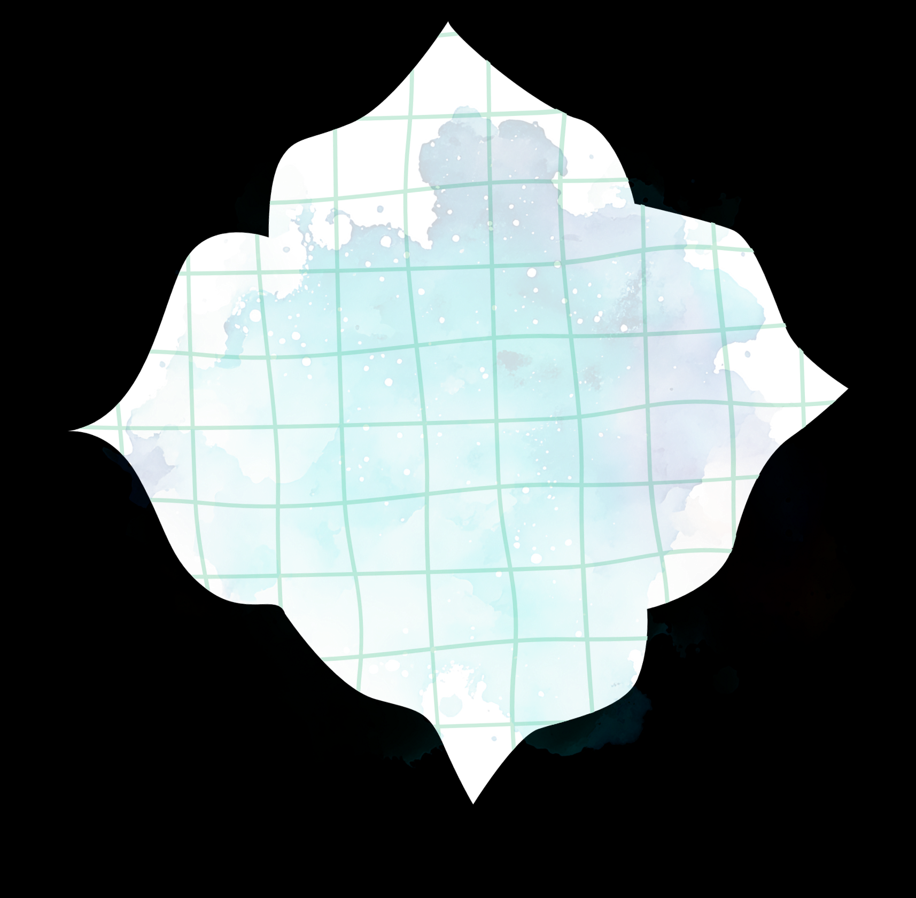
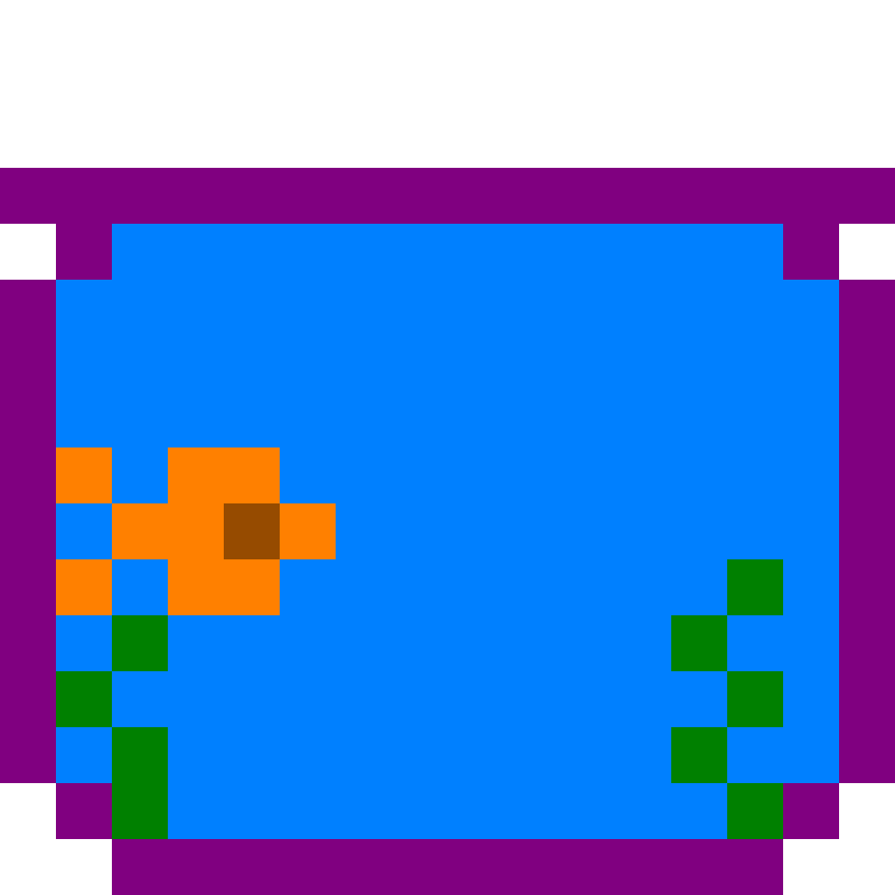
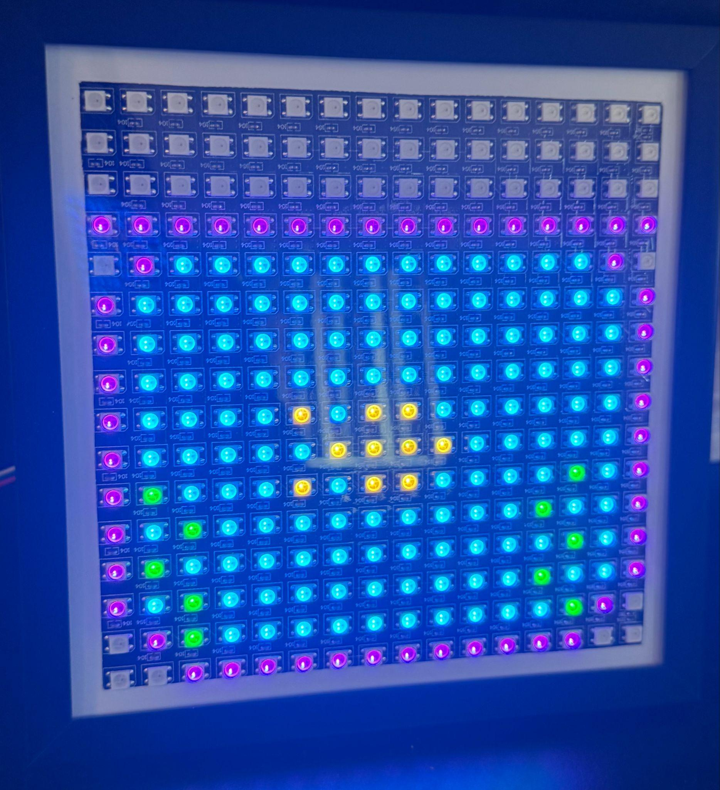

Digital Desktank!
Renee Wrysinski, Paulina Arizpe-Romo, Oyinkansola Sobakin-Ashebu, Emmie Casey, Timauri-Lee Carby
Notes:
debbie

Slide 2



System Overview
The design is based on the Tamagotchi, which is also based on playing with a digital pet.
Utilizes Neopixels to create fish tank display.
Neopixels → individually addressable LEDs on a grid.
User is able to interact with the fish tank via four buttons – interaction is determined by a finite state machine (FSM); one of four actions can be executed:
make the fish go to sleep,
feed it,
make it swim faster,
or play a game of hide and seek.
Various modular functions were created to build game play, as well as animation and sound on the display for a more interactive experience with the device.

Slide 3
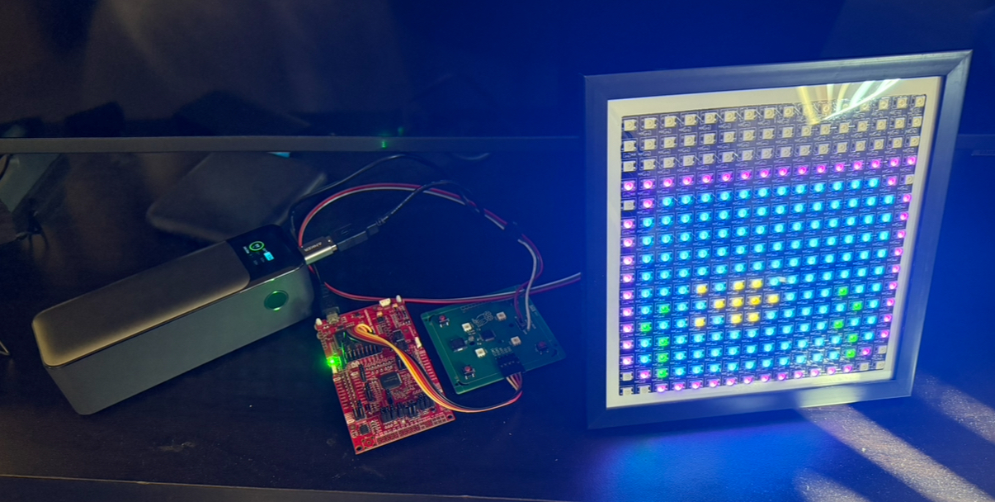

System Hardware
battery pack (power supply)
16x16 Neopixel LED grid
System is currently composed of a battery pack, Launchpad, Simon board, and 16x16 Neopixel grid
Could also be powered with 2 AA batteries in a holder soldered to Simon board, eliminating need for Launchpad and battery pack
Launchpad only necessary for programming and currently providing power from USB
Launchpad
Simon board
Notes:
renee

Slide 4

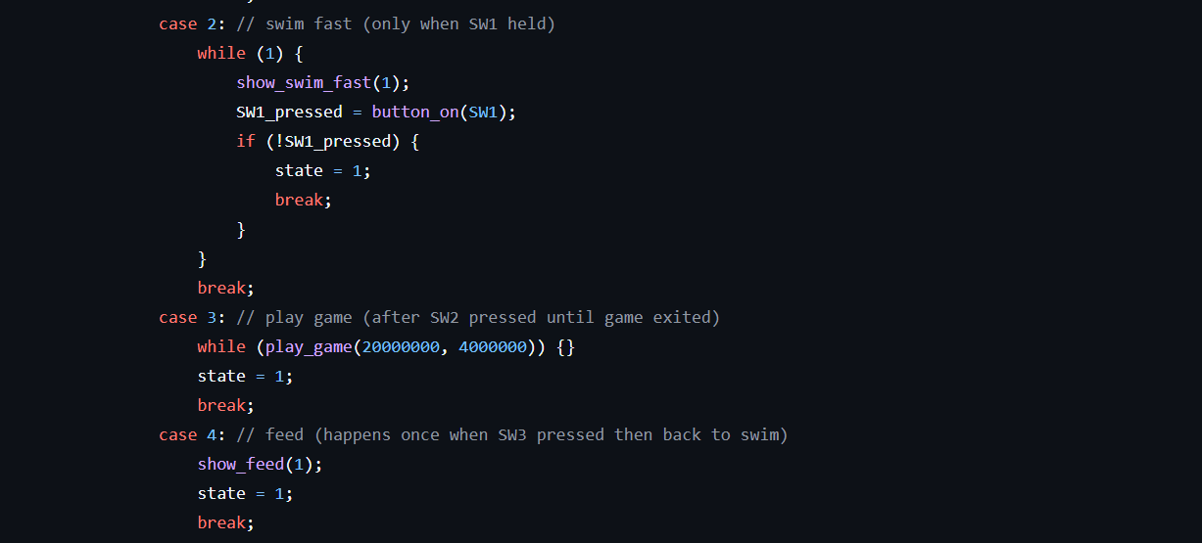

Implementation Overview: Functions

Slide 5
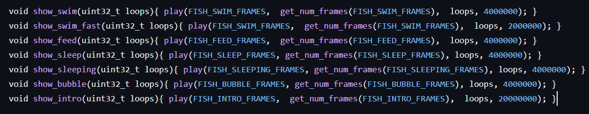
Functions for Fish Tank Interaction
animations.c
where frames are animated for use in various states in our FSM
show_x functions represent animation ‘packets’ and are governed by the same general logic:
get series of frame from image_frames.h
repeats animation a given number of times
waits a given number of seconds before moving to next frame series
implementation in code
Notes:
timauri

Slide 6
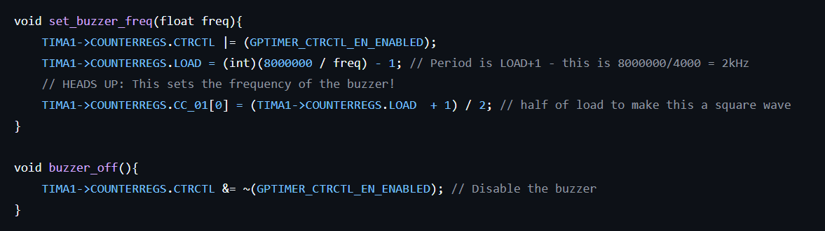
Functions for Fish Tank Interaction
effects.c
Where our music packets are defined.
Built off code from ELEC 327 Lab 7.
Made code more modular by moving setting of buzzer frequency and note and duration definition to its own header (note.h)
implementation in code:
Notes:
timauri

Slide 7
Functions for Fish Tank Interaction
display.c
converts the image frame arrays defined in image_frames.h to SPI packets that are then sent to the Neopixels grid to create the actual display
convert 8-bit color value from image_frames.h to 9-bit neopixel SPI encoding
map 2D image matrix to 1D array to fit on neopixels strip
adjust brightness
converts image from RGB to GRB and sends frame to neopixel strip via SPI
apply 9-bit conversion to each pixel in image to create frame
Notes:
timauri

Slide 8
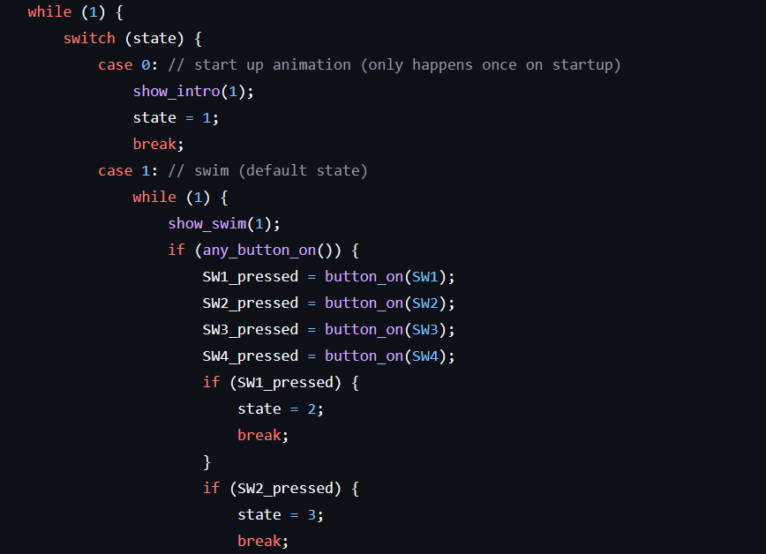
Functions for Fish Tank Interaction
main.c
Contains logic for the FSM that governs how the user interacts with the fish tank.
code snippet:
Notes:
timauri

Slide 9
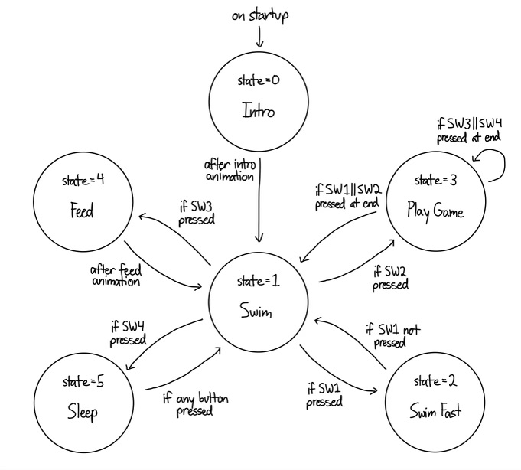
Implementation Overview: FSM Controller

Slide 10

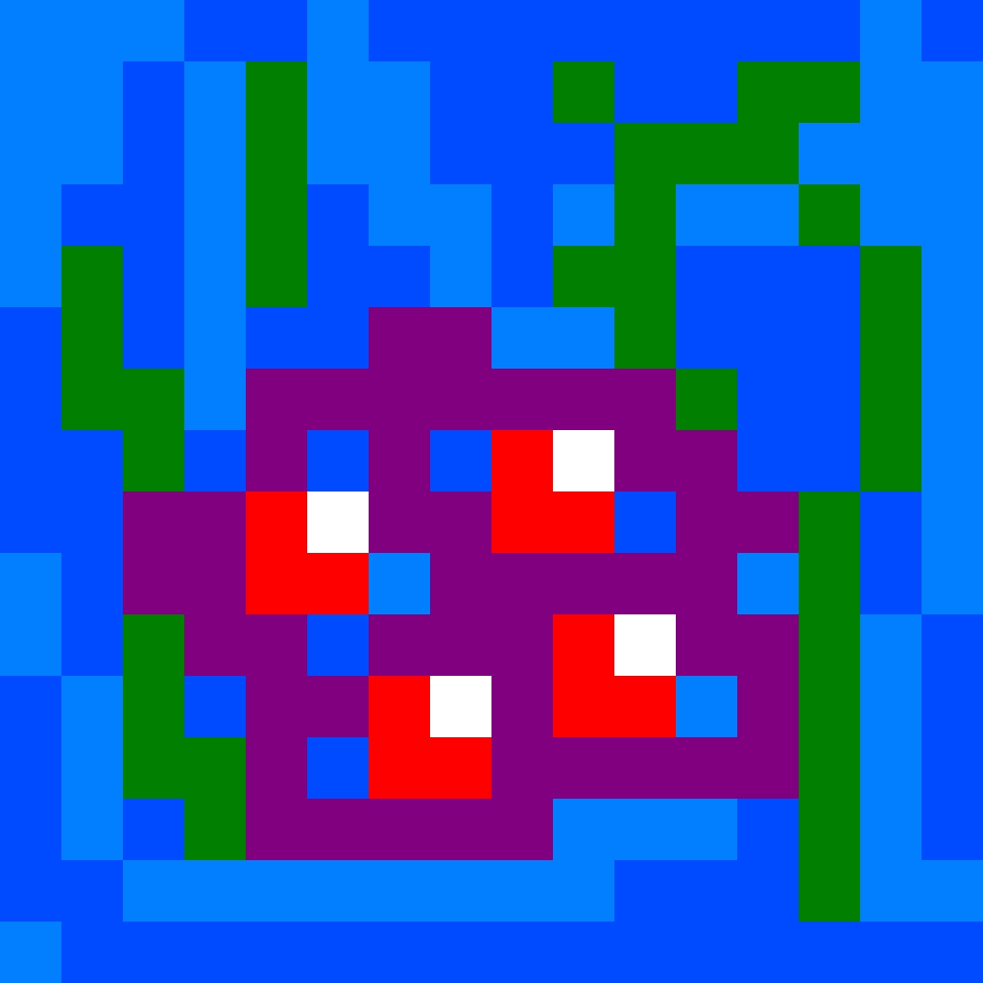
State = 0:
Intro

Slide 11

State = 1:
Swim

Slide 12
State = 2:
Swim Fast
SW1

Slide 13
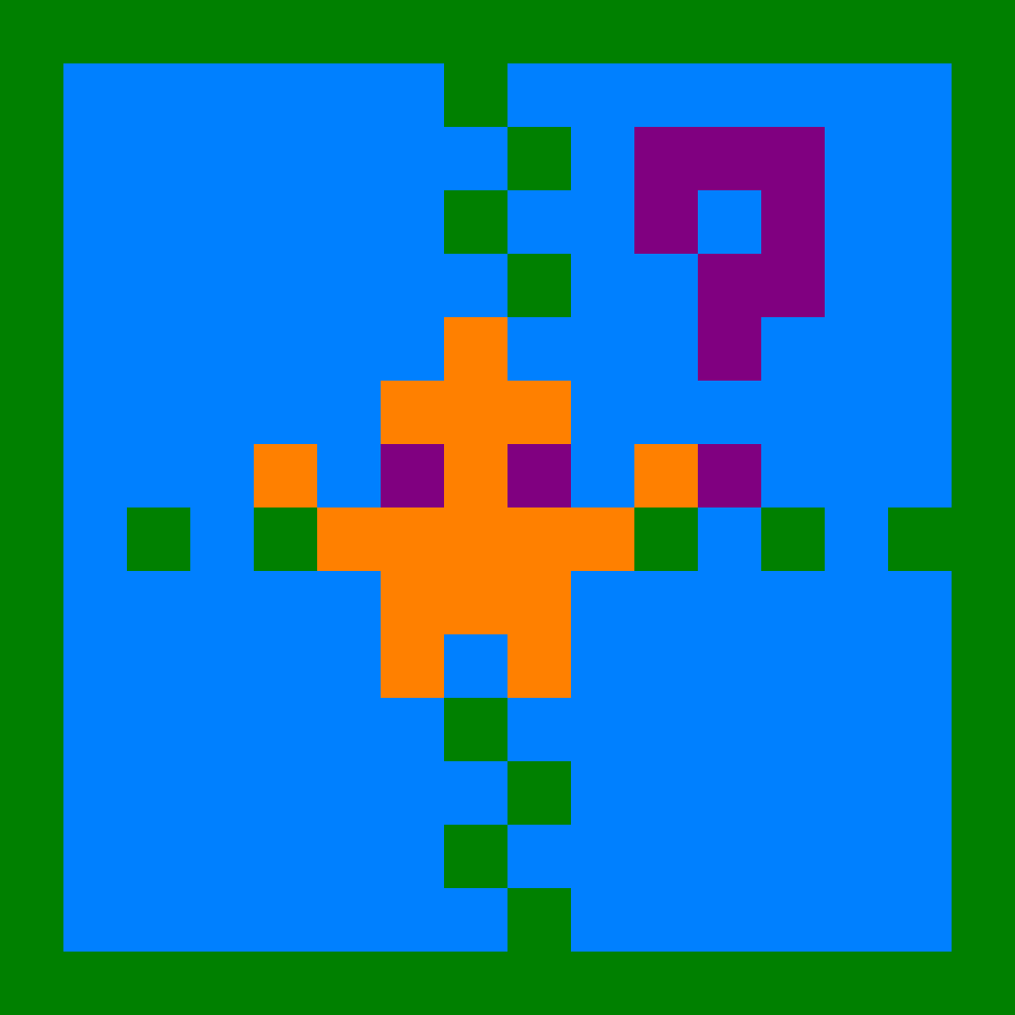
State = 3:
Play Game
SW2

Slide 14
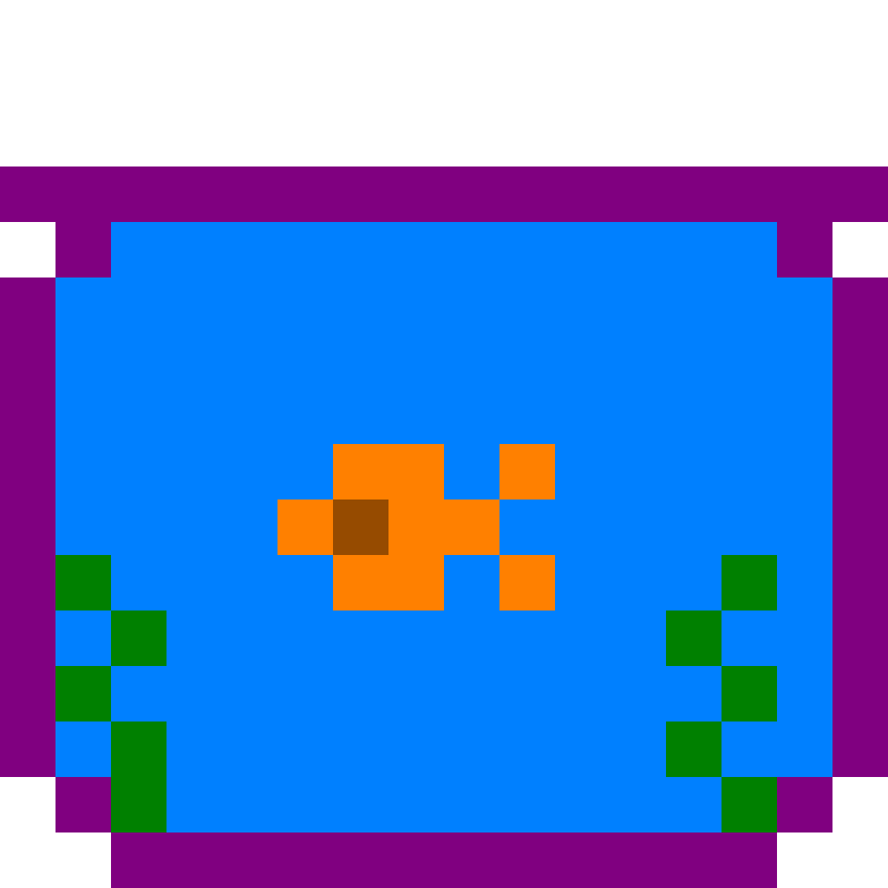
State = 4:
Feed
SW3

Slide 15
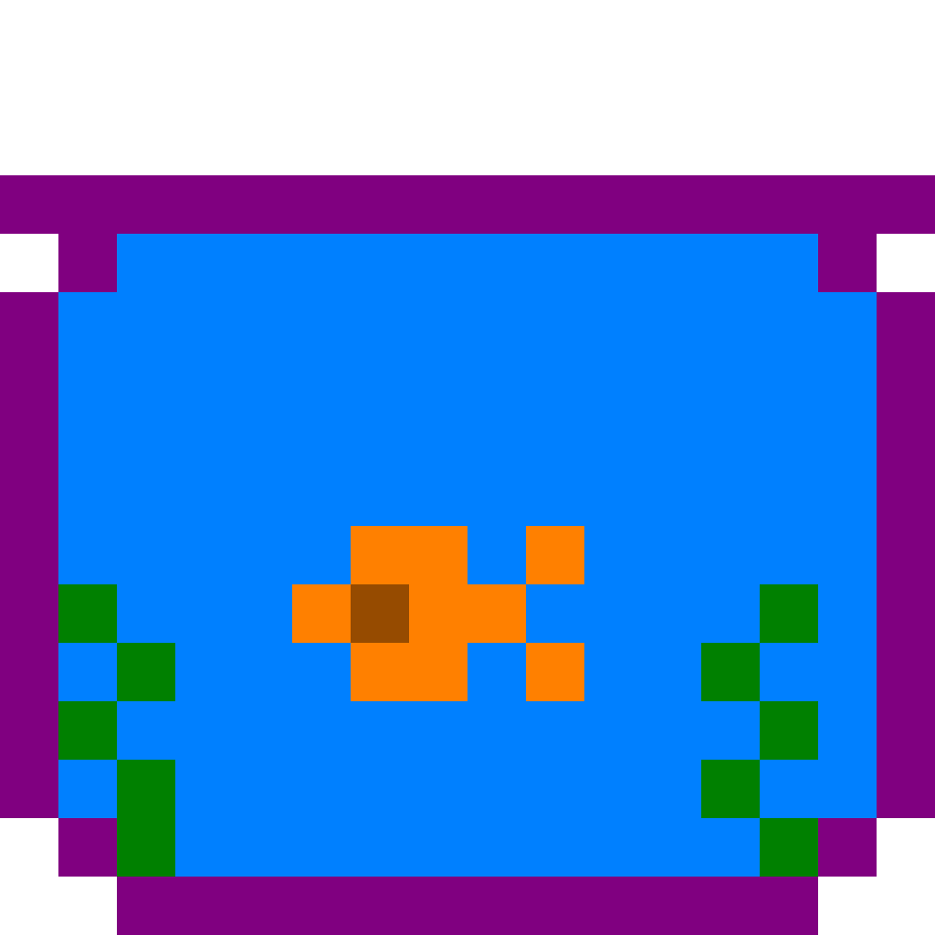
State = 5:
Sleep
SW4

Slide 16
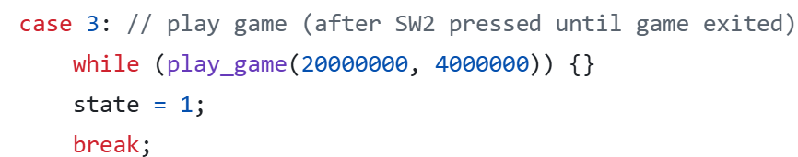
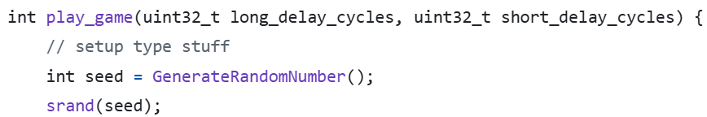
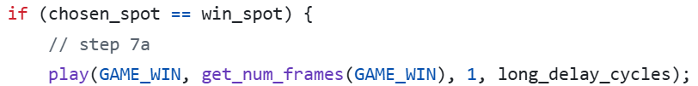
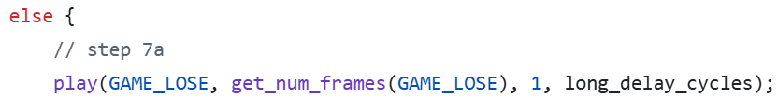
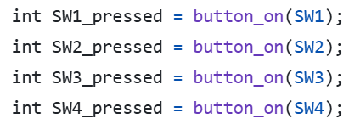
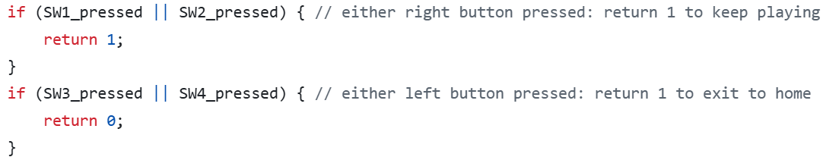
Game Logic
SW2 is pressed in state 1 (swim) → sets state = 3 (play game).
Seed the TRNG.
Play GAME_INTRO.
User chooses a spot via button press.
A spot is randomly selected as the winning spot.
After a wave animation, one of four win-spot animations plays.
If user guessed right, show win animation. Otherwise, show lose animation.
Choose to continue playing or exit via button press.
Notes:
debbie

Slide 17
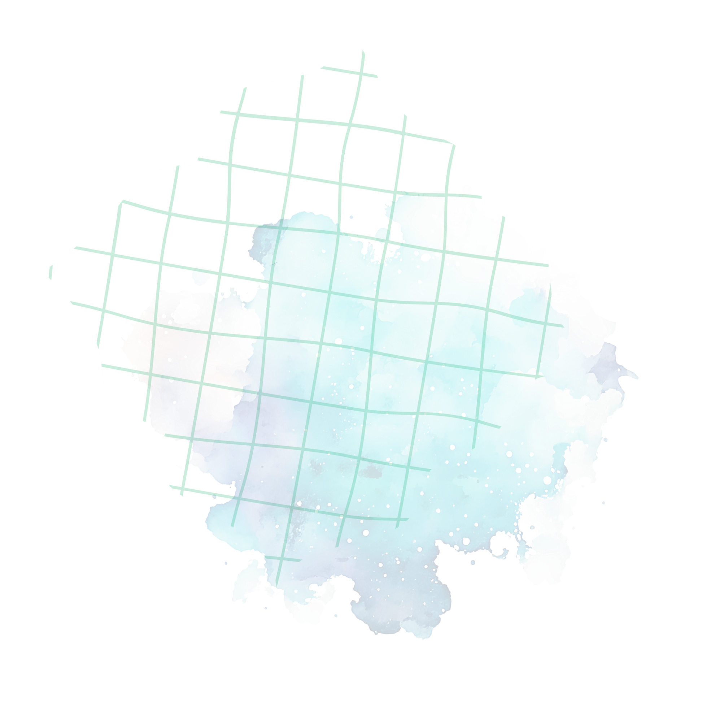
Thank you!!

